Slide 1
LONGEST INCREASING SUBSEQUENCES: FROM PATIENCE SORTING TO THE BAIK-DEIFT JOHANSSON THEOREM
DAVID ALDOUS AND PERSI DIACONIS
BULLETIN (New Series) OF THE AMERICAN MATHEMATICAL SOCIETY
Vol.36, Number 4, pp. 413 - 432
Date: Aug. 22, 2007
Introducer: Chung-Han Chiang

Slide 2
Abstract
We describe a simple one-person card game, patience sorting. Its analysis leads to a broad circle of ideas linking Young tableaux with the longest increasing subsequence of a random permutation via the Schensted correspondence.
A recent highlight of this area is the work of Baik-Deift-Johansson which yields limiting probability laws via hard analysis of Toeplitz determinants.

Slide 3
Patience Sorting
Rules：
A low card may be placed on a higher card
(e.g. 2 may be placed on 7), or may be put into a new pile to the right of the existing piles.
Input：
7
2
1
3
4
6
5
Input：a sequence
Output：
7
2
1
3
4
6
5
Output：a longest increasing subsequence (LIS)

Slide 4
Example
7
2
8
1
3
4
10
6
9
5
7
2
8
1
3
4
10
6
9
5
right？

Slide 5
7
2
8
1
3
4
10
6
9
5
7
2
8
1
3
4
10
6
9
5
right！
Define ：
l(π) to be the length of the longest increasing subsequence of a permutation .

Slide 6
Reduction
Cbyang, “Chap 8.The Theory of NP-Completeness”, pp.3：
Definition of reduction: Problem A reduces to problem B (A ∝ B) iff A can be solved by a deterministic polynomial time algorithm using a deterministic algorithm that solves B in polynomial time.
Patience Sorting ∝ THE YOUNG TABLEAU METHOD

Slide 7
THE YOUNG TABLEAU METHOD
Young diagram
A Young diagram (also called Ferrers diagram) is a way to represent partitions of a number n. Let n be a natural number. A partition is a way of expressing n as a sum of natural numbers: n = k₁ + k₂ + ... + k_{m}, where k₁ ≥ k₂ ≥ ....
ex：10 = 5 + 4 + 1
a
b
Hook length formula
ex：ha = 1 + 4 + 2 = 7
hb = 1 + 2 = 3
A hook length hx of a box x in Young diagram λ is the number of boxes that are in the same row to the right of it plus those boxes in the same column below it, plus one (for the box itself).

Slide 8
Young Tableau
P-tableau
7
2
8
1
3
4
10
6
9
5
First row
in each row, the numbers must be increasing from left to right;
in each column, the numbers must be increasing from top to bottom
Second row
Third row
1
3
4
5
9
1
5
2
6
10
2
3
6
7
8
7
8
4
10
9
The top row in the P-tableau is the same as
the row of top cards in patience sorting.

Slide 9
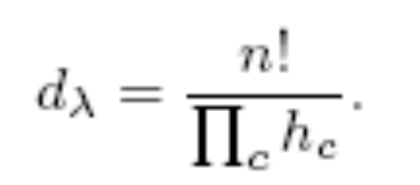
By the hook-length formula, the dimension of an irreducible representation is n! divided by the product of the hook lengths of all boxes in the diagram of the representation:
1
1
3
1
2
2
EX：1,2,3
1
2
3
2
3
3
EX：1~4
1
2
3
4
1
2
1
3
1
3
4
3
2
4
2
1
2
3
4
1
4
1
3
1
4
2
1
2
4
1
2
2
2
3
3
3
4
4
3
4

Slide 10
a(n) = a(n-1) + (n-1)*a(n-2)
1, 1, 2, 4, 10, 26, 76, 232, 764, 2620, 9496, 35696, 140152, 568504, 2390480, 10349536, 46206736, 211799312, 997313824, 4809701440, 23758664096, 119952692896, 618884638912, 3257843882624, 17492190577600, 95680443760576 …
Knuth, “THE ART OF COMPUTER PROGRAMMING”, pp.65：
…,we obtain the formula t_{n} = t_{n-1} + (n-1)*t_{n-2} which Rothe devise in 1800 to tabulate t_{n} for small n.

Slide 11
Conclusion
The Schensted (or Robinson-Schensted-Knuth) correspondence is a bijection between permutations of n cards and ordered pairs of Young tableaux of size n with the same (unspecied) shape .

Slide 12
a(n) = a(n-1) + (n-1)*a(n-2)
80 245789798368839780414239398545880224872312250090845785136562176
81 2331227186521662253946874294671432510505315566066239124433534976
82 22240200854397684467500265576887730725162607823424747720495071232
83 213400830149173989291143957739945196586598484240856355924044939264
84 2059337501064181800093666000621626846775094933585110416725135851520
85 19985007233594796900549758450777023360049367609817044314344910749696
86 195028694824050249908511368503615305335932436964551429735981458128896
87 1913739316913202783355790595270439314300178051408817240769643782602752
88 18881235766605574525396279655084970878526300067324791627800030639816704
89 187290295654967419460705852038883630536941968591300708815528683508858880
90 1867720278882863552220974741341446038725782674583207163689731410452545536
91 18723846887829931303684501424840972787050559847800270957087312926249844736
92 188686392266170514555793202886912562311096783234872122852852871277431488512
93 1911280305946524194494767333972282058719748289232497050904885660492417204224
94 19459114786700382048183535202455150353651749130075604476220202689293545635840
95 199119463545673656330691664595849663873308088317930327261279454775580762832896
96 2047735368282209950908127508829088947470224255675112752502198710258467598237696
97 21163203868666880958654527310030656679307800734196424169585026368714220830195712
98 219793534592041246196742895666452284583919553534682361162298301263785577859252224
99 2293787513721395580144886572049456639156084025485931929781630885397779219218432000
100 24053347438333478953622433243028232812964119825419485684849162710512551427284402176

Slide 13
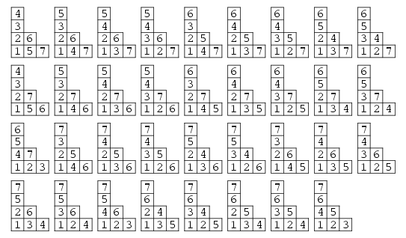
1~7 Young Tableau

Slide 14
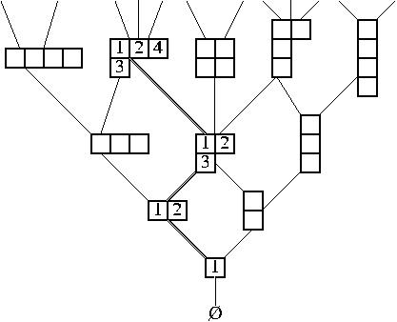
Young Lattice
Young lattice. (Image by Prof. Postnikov.)

Slide 15
REFERENCE
http://mathworld.wolfram.com/YoungTableau.html
http://mathworld.wolfram.com/HookLengthFormula.html
http://en.wikipedia.org/wiki/Young_tableau
http://en.wikipedia.org/wiki/Robinson-Schensted_algorithm
http://www.research.att.com/~njas/sequences/A000085
http://www.myoops.org/twocw/mit/Mathematics/18-312Spring-2005/CourseHome/index.htm
Knuth, Donald E. The Art of Computer Programming.

